Slide 1
Week 5 – The firm. Externalities. Public goods
EC1101E, NUS, Spring 2020. Week 5. Guillem Riambau

Slide 2
Today
What happens when our activities hurt/benefit others?
How can the goverment prevent/incentivize them?
What happens with goods that are not privately consumed?
How do firms decide exactly how much to produce?
EC1101E, NUS, Spring 2020. Week 5. Guillem Riambau

Slide 3
Today, more technically
Externalities
Government intervention
Public goods
The decision of the firm
EC1101E, NUS, Spring 2020. Week 5. Guillem Riambau

Slide 4
Today, in more detail
Externalities & Government intervention
Overlook + one example today
More examples in the tutorial
Public goods
Pre-lecture slides (3) and video
More examples in the tutorial
The decision of the firm
Brief overlook today
More details on the firm in perfect competition in Pre-Lecture slides (1) and (2), and pre-lecture videos (1) and (2)
More details of the long run decisions in the tutorial
EC1101E, NUS, Spring 2020. Week 5. Guillem Riambau

Slide 5
Today, in more detail
Externalities & Government intervention
Overlook + one example today
More examples in the tutorial
Public goods
Pre-lecture slides (3) and video
More examples in the tutorial
The decision of the firm
Brief overlook today
More details on the firm in perfect competition in Pre-Lecture slides (1) and (2), and pre-lecture videos (1) and (2)
More details of the long run decisions in the tutorial
EC1101E, NUS, Spring 2020. Week 5. Guillem Riambau

Slide 6
Today, in more detail
Externalities & Government intervention
Overlook + one example today
More examples in the tutorial
Public goods
Pre-lecture slides (3) and video
More examples in the tutorial
The decision of the firm
Brief overlook today
More details on the firm in perfect competition in Pre-Lecture slides (1) and (2), and pre-lecture videos (1) and (2)
More details of the long run decisions in the tutorial
EC1101E, NUS, Spring 2020. Week 5. Guillem Riambau

Slide 7
Today, in more detail
Externalities & Government intervention
Overlook + one example today
More examples in the tutorial
Public goods
Pre-lecture slides (3) and video
More examples in the tutorial
The decision of the firm
Brief overlook today
More details on the firm in perfect competition in Pre-Lecture slides (1) and (2), and pre-lecture videos (1) and (2)
More details of the long run decisions in the tutorial
EC1101E, NUS, Spring 2020. Week 5. Guillem Riambau

Slide 8
Externalities
EC1101E, NUS, Spring 2020. Week 5.

Slide 9
Externalities
Examples
Definition
Modeling in a graph
Finding the social optimum
What can governments do? Finding the correct policy
Welfare analysis
Can governments implement wrong policies? (tutorial)
EC1101E, NUS, Spring 2020. Week 5.

Slide 10
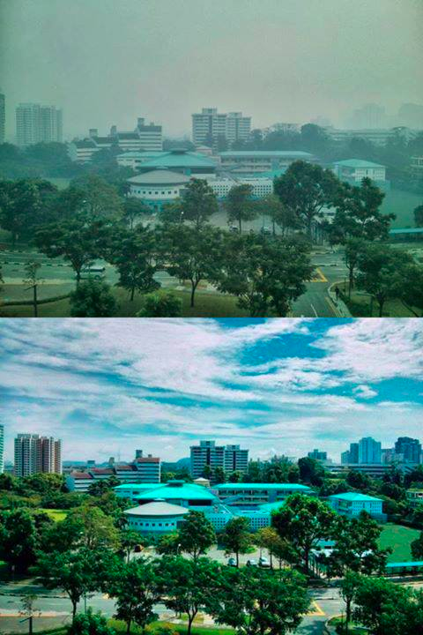
Externalities
Singapore, June 2013.
New Town Secondary School
from RC4 (U-Town)
EC1101E, NUS, Spring 2020. Week 5.

Slide 11
Examples
EC1101E, NUS, Spring 2020. Week 5.

Slide 12
Examples
EC1101E, NUS, Spring 2020. Week 5.

Slide 13
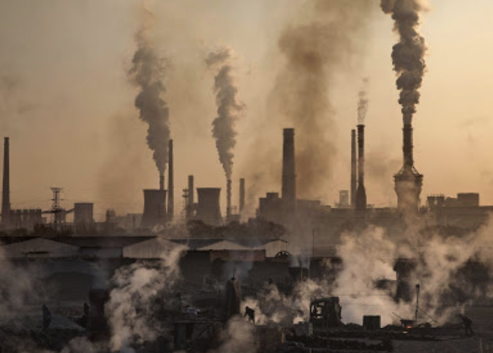
Examples
EC1101E, NUS, Spring 2020. Week 5.

Slide 14
Examples
EC1101E, NUS, Spring 2020. Week 5.

Slide 15
Examples
EC1101E, NUS, Spring 2020. Week 5.

Slide 16
Examples
EC1101E, NUS, Spring 2020. Week 5.

Slide 17
Examples
EC1101E, NUS, Spring 2020. Week 5.

Slide 18
Externalities
Definition: Cost or benefit born by a third party who is not directly involved in the production or consumption scheme of that good or service
EC1101E, NUS, Spring 2020. Week 5.

Slide 19
Externalities
Definition: Cost or benefit born by a third party who is not directly involved in the production or consumption scheme of that good or service
EC1101E, NUS, Spring 2020. Week 5.

Slide 20
Externalities
Examples
Definition
Modeling in a graph
Finding the social optimum
What can governments do? Finding the correct policy
Welfare analysis
Can governments implement wrong policies? (tutorial)
EC1101E, NUS, Spring 2020. Week 5.

Slide 21
Externalities: how do we model them?
EC1101E, NUS, Spring 2020. Week 5.

Slide 22
P
D
S
Q
EC1101E, NUS, Spring 2020. Week 5.

Slide 23
P
DEMAND =
Mg. Private Benefit
Supply =
Mg. Private Cost
Q
EC1101E, NUS, Spring 2020. Week 5.

Slide 24
P
DEMAND =
Mg. Private Benefit
Supply =
Mg. Private Cost
To see why,
“Video 1 The Firm (Part 2) POSTED”
“Week 5. Firm Theory. Part 2. e-Lecture” slides
Q
EC1101E, NUS, Spring 2020. Week 5.

Slide 25
P
DEMAND =
Mg. Private Benefit
Supply =
Mg. Private Cost
Q
EC1101E, NUS, Spring 2020. Week 5.

Slide 26
P
Mg. Private Benefit
Mg. Private Cost
Noisy and polluting factory
Clear negative externality
Q
EC1101E, NUS, Spring 2020. Week 5.

Slide 27
P
Mg. Private Benefit
Mg. Private Cost
Consumption or production externality?
Consumption → Demand curve
Production –> Supply curve
Q
EC1101E, NUS, Spring 2020. Week 5.

Slide 28
P
Mg. Private Benefit
Mg. Private Cost
Consumption or production externality?
Consumption → Demand curve
Production –> Supply curve
Q
EC1101E, NUS, Spring 2020. Week 5.

Slide 29
P
Mg. Social Cost
Mg. Private Benefit
Mg. Private Cost
Q
EC1101E, NUS, Spring 2020. Week 5.

Slide 30
P
Mg. Social Cost
Mg. Private Benefit
Mg. Private Cost
Q
EC1101E, NUS, Spring 2020. Week 5.

Slide 31
P
Mg. Social Cost
Mg. Private Benefit
Mg. Private Cost
The vertical distance is the externality cost
Q
EC1101E, NUS, Spring 2020. Week 5.

Slide 32
P
Mg. Social Cost
Mg. Private Benefit
Mg. Private Cost
Q
EC1101E, NUS, Spring 2020. Week 5.

Slide 33
P
Mg. Social Cost
Mg. Private Benefit
Mg. Private Cost
This is the cost of the firm from producing the Q₁–th unit
Q₁
Q
EC1101E, NUS, Spring 2020. Week 5.

Slide 34
P
Mg. Social Cost
Mg. Private Benefit
Mg. Private Cost
This is the cost for society from the production of the Q₁–th unit.
For instance, cost of polluting.
Q₁
Q
EC1101E, NUS, Spring 2020. Week 5.

Slide 35
P
Mg. Social Cost
Mg. Private Benefit
Mg. Private Cost
This is the TOTAL SOCIAL COST (externality + private) from the production of the Q₁–th unit.
Q₁
Q
EC1101E, NUS, Spring 2020. Week 5.

Slide 36
P
Mg. Private Benefit =
Mg. Social Benefit
Mg. Social Cost
Mg. Private Cost
This is the TOTAL SOCIAL COST (externality + private) from the production of the Q₁–th unit.
Q₁
Q
EC1101E, NUS, Spring 2020. Week 5.

Slide 37
Externalities
Examples
Definition
Modeling in a graph
Finding the social optimum
What can governments do? Finding the correct policy
Welfare analysis
Can governments implement wrong policies? (tutorial)
EC1101E, NUS, Spring 2020. Week 5.

Slide 38
P
Mg. Social Cost
Mg. Private Benefit
Mg. Private Cost
What is the optimal for society?
Q
EC1101E, NUS, Spring 2020. Week 5.

Slide 39
P
Mg. Social Cost
Mg. Private Benefit
Mg. Private Cost
What is the optimal for society? = Maximize surplus
Q
EC1101E, NUS, Spring 2020. Week 5.

Slide 40
P
Mg. Social Cost
Mg. Private Benefit =
Mg. Social Benefit
Mg. Private Cost
Is Q’ socially optimal?
Q’
Q
EC1101E, NUS, Spring 2020. Week 5.

Slide 41
P
Mg. Social Cost
Mg. Private Benefit =
Mg. Social Benefit
Mg. Private Cost
Mg. Social Cost of Q’
Mg. Social Benefit of Q’
Q’
Q
EC1101E, NUS, Spring 2020. Week 5.

Slide 42
P
Mg. Social Cost
Mg. Private Benefit =
Mg. Social Benefit
Mg. Private Cost
Mg. Social Cost of Q’
Mg. Social Benefit of Q’
Mg. Social Cost of Q’ > Mg. Social Benefit of Q’
Q’
Q
EC1101E, NUS, Spring 2020. Week 5.

Slide 43
P
Mg. Social Cost
Mg. Private Benefit =
Mg. Social Benefit
Mg. Private Cost
Mg. Social Cost of Q’
Mg. Social Benefit of Q’
Too much production
Q’
Q
EC1101E, NUS, Spring 2020. Week 5.

Slide 44
P
Mg. Social Cost
Mg. Private Benefit =
Mg. Social Benefit
Mg. Private Cost
Is Q’ socially optimal?
Q’
Q
EC1101E, NUS, Spring 2020. Week 5.

Slide 45
P
Mg. Social Cost
Mg. Private Benefit =
Mg. Social Benefit
Mg. Private Cost
Is Q’ socially optimal?
Q’
Q
EC1101E, NUS, Spring 2020. Week 5.

Slide 46
P
Mg. Social Cost
Mg. Private Benefit =
Mg. Social Benefit
Mg. Private Cost
Is Q’ socially optimal?
Q’
Q
EC1101E, NUS, Spring 2020. Week 5.

Slide 47
P
Mg. Social Cost
Mg. Private Benefit =
Mg. Social Benefit
Mg. Private Cost
Increasing production increases social welfare!
Q’
Q
EC1101E, NUS, Spring 2020. Week 5.

Slide 48
P
Mg. Social Cost
Mg. Private Benefit =
Mg. Social Benefit
Mg. Private Cost
Too little production!
Q’
Q
EC1101E, NUS, Spring 2020. Week 5.

Slide 49
P
Mg. Social Cost
Mg. Private Benefit =
Mg. Social Benefit
Mg. Private Cost
So what is the optimal level of production?
Q
EC1101E, NUS, Spring 2020. Week 5.

Slide 50
P
Mg. Social Cost
Mg. Private Benefit =
Mg. Social Benefit
Mg. Private Cost
Mg. Social Cost of Q**
= Mg. Social Benefit of Q**
Q** is the socially optimal level
Q**
Q
EC1101E, NUS, Spring 2020. Week 5.

Slide 51
Externalities
Examples
Definition
Modeling in a graph
Finding the social optimum
What can governments do? Finding the correct policy
Welfare analysis
Can governments implement wrong policies? (tutorial)
EC1101E, NUS, Spring 2020. Week 5.

Slide 52
P
Mg. Private Benefit =
Mg. Social Benefit
Mg. Private Cost
How can the government achieve Q**?
Q**
Q
EC1101E, NUS, Spring 2020. Week 5.

Slide 53
P
Mg. Private Benefit =
Mg. Social Benefit
Mg. Private Cost
$x
One possibility:
Taxing suppliers $x per unit sold
Q**
Q
EC1101E, NUS, Spring 2020. Week 5.

Slide 54
P
Mg. Private Benefit =
Mg. Social Benefit
Mg. Private Cost
Is there any other option?
Q**
Q
EC1101E, NUS, Spring 2020. Week 5.

Slide 55
P
Mg. Private Benefit =
Mg. Social Benefit
Mg. Private Cost
YES!
Taxing consumers $x per unit bought
$x
Q**
Q
EC1101E, NUS, Spring 2020. Week 5.

Slide 56
Externalities
Can you think of other alternatives?
Quotas
Price limits
Both of them affect quantities in the market
EC1101E, NUS, Spring 2020. Week 5.

Slide 57
Externalities
Can you think of other alternatives?
Quotas
Price limits
Both of them affect quantities in the market
EC1101E, NUS, Spring 2020. Week 5.

Slide 58
Externalities
Examples
Definition
Modeling in a graph
Finding the social optimum
What can governments do? Finding the correct policy
Welfare analysis
Can governments implement wrong policies? (tutorial)
EC1101E, NUS, Spring 2020. Week 5.

Slide 59
Welfare Analysis
P
Mg. Social Cost
Mg. Private Benefit
Mg. Private Cost
First assume free market: no taxes or subsidies
Q
EC1101E, NUS, Spring 2020. Week 5.

Slide 60
P
Mg. Social Cost
Mg. Private Benefit
Mg. Private Cost
Q
EC1101E, NUS, Spring 2020. Week 5.

Slide 61
P
Mg. Social Cost
Mg. Private Benefit
Mg. Private Cost
CS?
Q
EC1101E, NUS, Spring 2020. Week 5.

Slide 62
P
Mg. Social Cost
Mg. Private Benefit
Mg. Private Cost
CS
Q
EC1101E, NUS, Spring 2020. Week 5.

Slide 63
P
Mg. Social Cost
Mg. Private Benefit
Mg. Private Cost
PS?
Q
EC1101E, NUS, Spring 2020. Week 5.

Slide 64
P
Mg. Social Cost
Mg. Private Benefit
Mg. Private Cost
PS
Q
EC1101E, NUS, Spring 2020. Week 5.

Slide 65
P
Mg. Social Cost
Mg. Private Benefit
Mg. Private Cost
Externality cost?
Q
EC1101E, NUS, Spring 2020. Week 5.

Slide 66
P
Mg. Social Cost
Mg. Private Benefit
Mg. Private Cost
Externality cost?
1st unit
Q
EC1101E, NUS, Spring 2020. Week 5.

Slide 67
P
Mg. Social Cost
Mg. Private Benefit
Mg. Private Cost
Externality cost?
2nd unit
Q
EC1101E, NUS, Spring 2020. Week 5.

Slide 68
P
Mg. Social Cost
Mg. Private Benefit
Mg. Private Cost
Externality cost?
3rd unit
Q
EC1101E, NUS, Spring 2020. Week 5.

Slide 69
P
Mg. Social Cost
Mg. Private Benefit
Mg. Private Cost
Externality cost?
4th unit
Q
EC1101E, NUS, Spring 2020. Week 5.

Slide 70
P
Mg. Social Cost
Mg. Private Benefit
Mg. Private Cost
Externality cost?
5th unit
Q
EC1101E, NUS, Spring 2020. Week 5.

Slide 71
P
Mg. Social Cost
Mg. Private Benefit
Mg. Private Cost
Externality cost?
6th unit
Q
EC1101E, NUS, Spring 2020. Week 5.

Slide 72
P
Mg. Social Cost
Mg. Private Benefit
Mg. Private Cost
Externality cost?
And so on
Q
EC1101E, NUS, Spring 2020. Week 5.

Slide 73
P
Mg. Social Cost
Mg. Private Benefit
Mg. Private Cost
Externality cost?
Q
EC1101E, NUS, Spring 2020. Week 5.

Slide 74
P
Mg. Social Cost
Mg. Private Benefit
Mg. Private Cost
Externality cost?
Q
EC1101E, NUS, Spring 2020. Week 5.

Slide 75
P
Mg. Social Cost
Mg. Private Benefit
Mg. Private Cost
Externality cost?
Q
EC1101E, NUS, Spring 2020. Week 5.

Slide 76
P
Mg. Social Cost
Mg. Private Benefit
Mg. Private Cost
Externality cost?
Q
EC1101E, NUS, Spring 2020. Week 5.

Slide 77
P
Mg. Social Cost
Mg. Private Benefit
Mg. Private Cost
Externality cost?
Q
EC1101E, NUS, Spring 2020. Week 5.

Slide 78
P
Mg. Social Cost
Mg. Private Benefit
Mg. Private Cost
Externality cost?
Q
EC1101E, NUS, Spring 2020. Week 5.

Slide 79
P
Mg. Social Cost
Mg. Private Benefit
Mg. Private Cost
Externality cost?
Q
EC1101E, NUS, Spring 2020. Week 5.

Slide 80
P
Mg. Social Cost
Mg. Private Benefit
Mg. Private Cost
Externality cost?
Q
EC1101E, NUS, Spring 2020. Week 5.

Slide 81
P
Mg. Social Cost
Mg. Private Benefit
Mg. Private Cost
Social Welfare?
Q
EC1101E, NUS, Spring 2020. Week 5.

Slide 82
P
Mg. Social Cost
Mg. Private Benefit
Mg. Private Cost
Social Welfare?
Q
EC1101E, NUS, Spring 2020. Week 5.

Slide 83
P
Mg. Social Cost
Mg. Private Benefit
Mg. Private Cost
Social Welfare?
Q
EC1101E, NUS, Spring 2020. Week 5.

Slide 84
P
Mg. Social Cost
Mg. Private Benefit
Mg. Private Cost
TOTAL SURPLUS
Q
EC1101E, NUS, Spring 2020. Week 5.

Slide 85
P
Mg. Social Cost
Mg. Private Benefit
Mg. Private Cost
Deadweight Loss
Q
EC1101E, NUS, Spring 2020. Week 5.

Slide 86
P
Mg. Social Cost
Mg. Private Benefit
Mg. Private Cost
How do we know this is the deadweight loss?
Q
EC1101E, NUS, Spring 2020. Week 5.

Slide 87
P
Mg. Social Cost
Mg. Private Benefit
Mg. Private Cost
Suppose optimal consumption (e.g., given adequate tax to suppliers)
Q
EC1101E, NUS, Spring 2020. Week 5.

Slide 88
P
Mg. Social Cost
Mg. Private Benefit
Mg. Private Cost
$x
Q
EC1101E, NUS, Spring 2020. Week 5.

Slide 89
P
Mg. Social Cost
Mg. Private Benefit
Mg. Private Cost
$x
Q**
Q
EC1101E, NUS, Spring 2020. Week 5.

Slide 90
P
Mg. Social Cost
Mg. Private Benefit
Mg. Private Cost
$x
P_{consumers}
Welfare?
P_{sellers}
Q**
Q
EC1101E, NUS, Spring 2020. Week 5.

Slide 91
P
Mg. Social Cost
Mg. Private Benefit
Mg. Private Cost
$x
P_{consumers}
P_{sellers}
Q**
Q
EC1101E, NUS, Spring 2020. Week 5.

Slide 92
P
Mg. Social Cost
Mg. Private Benefit
Mg. Private Cost
$x
P_{consumers}
Consumer surplus
P_{sellers}
Q**
Q
EC1101E, NUS, Spring 2020. Week 5.

Slide 93
P
Mg. Social Cost
Mg. Private Benefit
Mg. Private Cost
$x
P_{consumers}
Producer surplus
P_{sellers}
Q**
Q
EC1101E, NUS, Spring 2020. Week 5.

Slide 94
P
Mg. Social Cost
Mg. Private Benefit
Mg. Private Cost
$x
P_{consumers}
Government revenue
P_{sellers}
Q**
Q
EC1101E, NUS, Spring 2020. Week 5.

Slide 95
P
Mg. Social Cost
Mg. Private Benefit
Mg. Private Cost
$x
P_{consumers}
Negative externality?
P_{sellers}
Q**
Q
EC1101E, NUS, Spring 2020. Week 5.

Slide 96
P
Mg. Social Cost
Mg. Private Benefit
Mg. Private Cost
$x
P_{consumers}
Negative externality?
P_{sellers}
Q**
Q
EC1101E, NUS, Spring 2020. Week 5.

Slide 97
P
Mg. Social Cost
Mg. Private Benefit
Mg. Private Cost
$x
P_{consumers}
Negative externality?
P_{sellers}
Q**
Q
EC1101E, NUS, Spring 2020. Week 5.

Slide 98
P
Mg. Social Cost
Mg. Private Benefit
Mg. Private Cost
$x
P_{consumers}
Negative externality?
P_{sellers}
Q**
Q
EC1101E, NUS, Spring 2020. Week 5.

Slide 99
P
Mg. Social Cost
Mg. Private Benefit
Mg. Private Cost
$x
P_{consumers}
Negative externality?
P_{sellers}
Q**
Q
EC1101E, NUS, Spring 2020. Week 5.

Slide 100
P
Mg. Social Cost
Mg. Private Benefit
Mg. Private Cost
$x
P_{consumers}
Negative externality?
P_{sellers}
Q**
Q
EC1101E, NUS, Spring 2020. Week 5.

Slide 101
P
Mg. Social Cost
Mg. Private Benefit
Mg. Private Cost
$x
P_{consumers}
Negative externality?
P_{sellers}
Q**
Q
EC1101E, NUS, Spring 2020. Week 5.

Slide 102
P
Mg. Social Cost
Mg. Private Benefit
Mg. Private Cost
$x
P_{consumers}
Etc.
P_{sellers}
Q**
Q
EC1101E, NUS, Spring 2020. Week 5.

Slide 103
P
Mg. Social Cost
Mg. Private Benefit
Mg. Private Cost
$x
P_{consumers}
P_{sellers}
Q**
Q
EC1101E, NUS, Spring 2020. Week 5.

Slide 104
P
Mg. Social Cost
Mg. Private Benefit
Mg. Private Cost
$x
P_{consumers}
Negative externality
P_{sellers}
Q**
Q
EC1101E, NUS, Spring 2020. Week 5.

Slide 105
P
Mg. Social Cost
Mg. Private Benefit
Mg. Private Cost
$x
P_{consumers}
P_{sellers}
So what is total (net) surplus?
Q**
Q
EC1101E, NUS, Spring 2020. Week 5.

Slide 106
P
Mg. Social Cost
Mg. Private Benefit
Mg. Private Cost
$x
P_{consumers}
P_{sellers}
Q**
Q
EC1101E, NUS, Spring 2020. Week 5.

Slide 107
P
Mg. Social Cost
Mg. Private Benefit
Mg. Private Cost
$x
P_{consumers}
P_{sellers}
Q**
Q
EC1101E, NUS, Spring 2020. Week 5.

Slide 108
P
Mg. Social Cost
Mg. Private Benefit
Mg. Private Cost
$x
P_{consumers}
P_{sellers}
Q**
Q
EC1101E, NUS, Spring 2020. Week 5.

Slide 109
Welfare Analysis, before and after tax
P
Mg. Social Cost
Mg. Private Benefit
Mg. Private Cost
EC1101E, NUS, Spring 2020. Week 5.

Slide 110
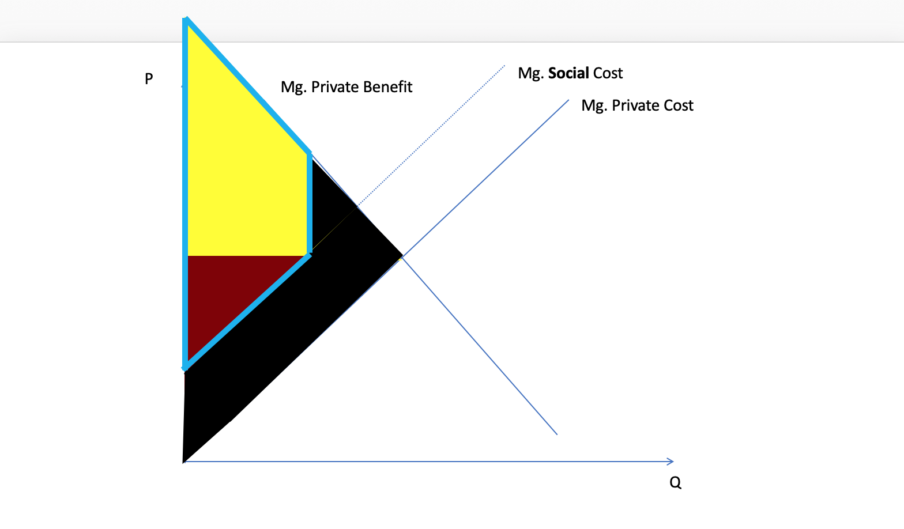
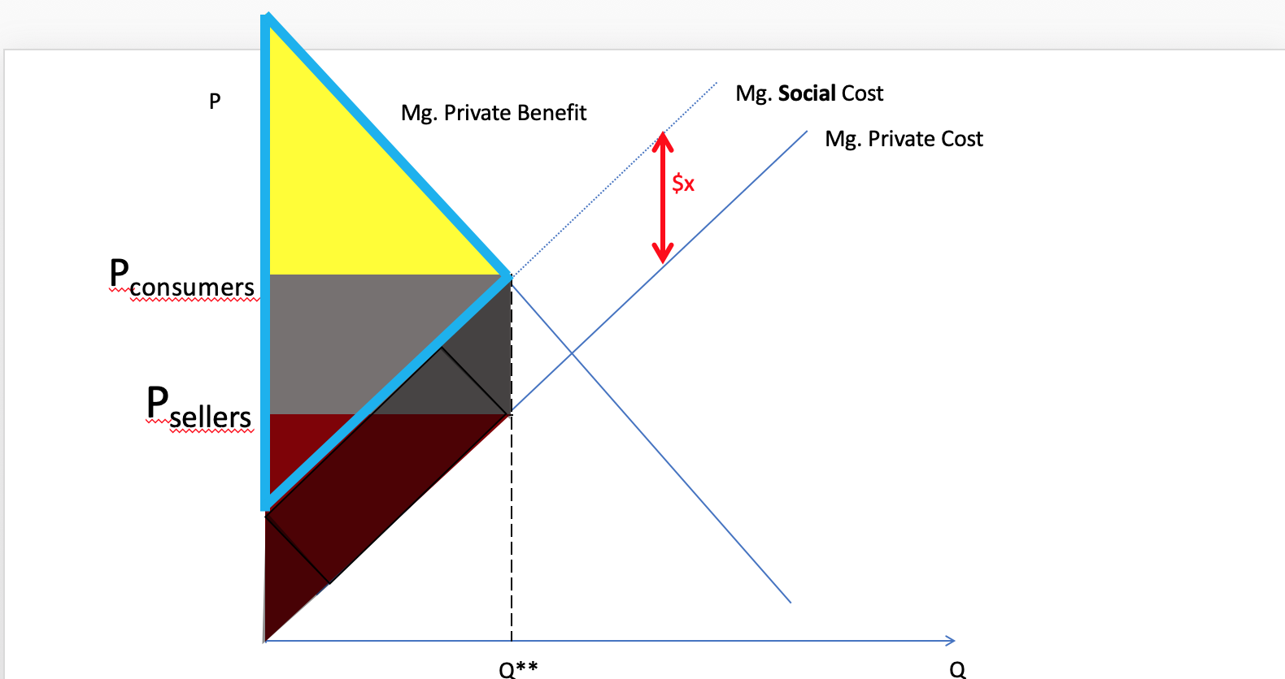
Before tax
After tax
EC1101E, NUS, Spring 2020. Week 5.

Slide 111
Before tax
After tax
EC1101E, NUS, Spring 2020. Week 5.

Slide 112
Before tax
After tax
After tax welfare clearly larger
This is the deadweight loss
EC1101E, NUS, Spring 2020. Week 5.

Slide 113
P
Mg. Social Cost
Mg. Private Benefit
Mg. Private Cost
Deadweight Loss
Q
EC1101E, NUS, Spring 2020. Week 5.

Slide 114
Today, in more detail
Externalities & Government intervention
Overlook + one example today
More examples in the tutorial
Public goods
Pre-lecture slides (3) and video
More examples in the tutorial
The decision of the firm
Brief overlook today
More details on the firm in perfect competition in Pre-Lecture slides (1) and (2), and pre-lecture videos (1) and (2)
More details of the long run decisions in the tutorial
EC1101E, NUS, Spring 2020. Week 5. Guillem Riambau

Slide 115
Demand for x
Demand for x:
P_{x} = 40 – 2Q_{x}
Re-arranging:
Q_{x} = 20 – P_{x}/2
We know firms are price takers. BUT, suppose for now that the firm can decide the quantity they produce (which implicitly as we see sets the price)
EC1101E, NUS, Spring 2020. Week 5. Guillem Riambau

Slide 116
Demand for x
Demand for x:
P_{x} = 40 – 2Q_{x}
Re-arranging:
Q_{x} = 20 – P_{x}/2
We know firms are price takers. BUT, suppose for now that the firm can decide the quantity they produce (which implicitly as we see sets the price)
40
20
EC1101E, NUS, Spring 2020. Week 5. Guillem Riambau

Slide 117
Demand for x
Demand for x:
P_{x} = 40 – 2Q_{x}
Re-arranging:
Q_{x} = 20 – P_{x}/2
We know firms are price takers. BUT, suppose for now that the firm can decide the quantity they produce (which implicitly as we see sets the price)
EC1101E, NUS, Spring 2020. Week 5. Guillem Riambau

Slide 118
Demand for x
Demand for x:
P_{x} = 40 – 2Q_{x}
Re-arranging:
Q_{x} = 20 – P_{x}/2
We know firms are price takers. BUT, suppose for now that the firm can decide the quantity they produce (which implicitly as we see sets the price)
VIDEO 2 Week 5 LumiNUS: The decision of the firm under perfect competition (i.e., when it cannot affect the price)
EC1101E, NUS, Spring 2020. Week 5. Guillem Riambau

Slide 119
Demand for x
Demand for x:
P_{x} = 40 – 2Q_{x}
Re-arranging:
Q_{x} = 20 – P_{x}/2
We know firms are price takers. BUT, suppose for now that the firm can decide the quantity they produce (which implicitly as we see sets the price)
What is the optimal quantity the firm should
sell in order to maximize profits?
EC1101E, NUS, Spring 2020. Week 5. Guillem Riambau

Slide 120
Externalities
Marginal Revenue
The decision of the firm: Marginal Cost
Graphical analysis
EC1101E, NUS, Spring 2020. Week 5.

Slide 121
Maximizing profits
EC1101E, NUS, Spring 2020. Week 5. Guillem Riambau

Slide 122
Maximizing profits
P | Q | TR | MR
EC1101E, NUS, Spring 2020. Week 5. Guillem Riambau

Slide 123
Maximizing profits
P | Q | TR | MR
Price
EC1101E, NUS, Spring 2020. Week 5. Guillem Riambau

Slide 124
Maximizing profits
P | Q | TR | MR
Quantity
EC1101E, NUS, Spring 2020. Week 5. Guillem Riambau

Slide 125
Maximizing profits
P | Q | TR | MR
Total Revenue = P x Q
EC1101E, NUS, Spring 2020. Week 5. Guillem Riambau

Slide 126
Maximizing profits
P | Q | TR | MR
Marginal
Revenue
Will become clear with the example that comes next
EC1101E, NUS, Spring 2020. Week 5. Guillem Riambau

Slide 127
Maximizing profits
P | Q | TR | MR
Marginal
Revenue
Additional revenue the firm gets by selling one more unit.
EC1101E, NUS, Spring 2020. Week 5. Guillem Riambau

Slide 128
Maximizing profits
P | Q | TR | MR
Demand for x:
P_{x} = 40 – 2Q_{x}
EC1101E, NUS, Spring 2020. Week 5. Guillem Riambau

Slide 129
Demand for x
Demand for x:
P_{x} = 40 – 2Q_{x}
Re-arranging:
Q_{x} = 20 – P_{x}/2
We know firms are price takers. BUT, suppose for now that the firm can decide the quantity they produce (which implicitly as we see sets the price)
40
20
EC1101E, NUS, Spring 2020. Week 5. Guillem Riambau

Slide 130
Maximizing profits
P | Q | TR | MR
 | 0
 | 1
 | 2
 | 3
 | 4
 | …
 | 8
 | 9
 | 10
 | 11
Demand for x:
P_{x} = 40 – 2Q_{x}
EC1101E, NUS, Spring 2020. Week 5. Guillem Riambau

Slide 131
Maximizing profits
P | Q | TR | MR
40 | 0
 | 1
 | 2
 | 3
 | 4
 | …
 | 8
 | 9
 | 10
 | 11
Demand for x:
P_{x} = 40 – 2Q_{x}
EC1101E, NUS, Spring 2020. Week 5. Guillem Riambau

Slide 132
Maximizing profits
P | Q | TR | MR
40 | 0 | 0
 | 1
 | 2
 | 3
 | 4
 | …
 | 8
 | 9
 | 10
 | 11
Demand for x:
P_{x} = 40 – 2Q_{x}
EC1101E, NUS, Spring 2020. Week 5. Guillem Riambau

Slide 133
Maximizing profits
P | Q | TR | MR
40 | 0 | 0 | 0
38 | 1
 | 2
 | 3
 | 4
 | …
 | 8
 | 9
 | 10
 | 11
Demand for x:
P_{x} = 40 – 2Q_{x}
EC1101E, NUS, Spring 2020. Week 5. Guillem Riambau

Slide 134
Maximizing profits
P | Q | TR | MR
40 | 0 | 0 | 0
38 | 1 | 38
 | 2
 | 3
 | 4
 | …
 | 8
 | 9
 | 10
 | 11
Demand for x:
P_{x} = 40 – 2Q_{x}
EC1101E, NUS, Spring 2020. Week 5. Guillem Riambau

Slide 135
Maximizing profits
P | Q | TR | MR
40 | 0 | 0 | 0
38 | 1 | 38 | 38
 | 2
 | 3
 | 4
 | …
 | 8
 | 9
 | 10
 | 11
Demand for x:
P_{x} = 40 – 2Q_{x}
Re-arranging:
Q_{x} = 20 – P_{x}/2
Marginal revenue: Difference in Total Revenue between selling 0 units and selling one additional unit (that is, one unit)
EC1101E, NUS, Spring 2020. Week 5. Guillem Riambau

Slide 136
Maximizing profits
P | Q | TR | MR
40 | 0 | 0 | 0
38 | 1 | 38 | 38
 | 2
 | 3
 | 4
 | …
 | 8
 | 9
 | 10
 | 11
Demand for x:
P_{x} = 40 – 2Q_{x}
Re-arranging:
Q_{x} = 20 – P_{x}/2
MR = 38 – 0 = 38
EC1101E, NUS, Spring 2020. Week 5. Guillem Riambau

Slide 137
Maximizing profits
P | Q | TR | MR
40 | 0 | 0 | 0
38 | 1 | 38 | 38
 | 2
 | 3
 | 4
 | …
 | 8
 | 9
 | 10
 | 11
Demand for x:
P_{x} = 40 – 2Q_{x}
EC1101E, NUS, Spring 2020. Week 5. Guillem Riambau

Slide 138
Maximizing profits
P | Q | TR | MR
40 | 0 | 0 | 0
38 | 1 | 38 | 38
36 | 2
 | 3
 | 4
 | …
 | 8
 | 9
 | 10
 | 11
Demand for x:
P_{x} = 40 – 2Q_{x}
EC1101E, NUS, Spring 2020. Week 5. Guillem Riambau

Slide 139
Maximizing profits
P | Q | TR | MR
40 | 0 | 0 | 0
38 | 1 | 38 | 38
36 | 2 | 72
 | 3
 | 4
 | …
 | 8
 | 9
 | 10
 | 11
Demand for x:
P_{x} = 40 – 2Q_{x}
EC1101E, NUS, Spring 2020. Week 5. Guillem Riambau

Slide 140
Maximizing profits
P | Q | TR | MR
40 | 0 | 0 | 0
38 | 1 | 38 | 38
36 | 2 | 72
 | 3
 | 4
 | …
 | 8
 | 9
 | 10
 | 11
Demand for x:
P_{x} = 40 – 2Q_{x}
Re-arranging:
Q_{x} = 20 – P_{x}/2
MR = 72 – 38 =
EC1101E, NUS, Spring 2020. Week 5. Guillem Riambau

Slide 141
Maximizing profits
P | Q | TR | MR
40 | 0 | 0 | 0
38 | 1 | 38 | 38
36 | 2 | 72
 | 3
 | 4
 | …
 | 8
 | 9
 | 10
 | 11
Demand for x:
P_{x} = 40 – 2Q_{x}
Re-arranging:
Q_{x} = 20 – P_{x}/2
MR = 72 – 38 = 34
EC1101E, NUS, Spring 2020. Week 5. Guillem Riambau

Slide 142
Maximizing profits
P | Q | TR | MR
40 | 0 | 0 | 0
38 | 1 | 38 | 38
36 | 2 | 72 | 34
 | 3
 | 4
 | …
 | 8
 | 9
 | 10
 | 11
Demand for x:
P_{x} = 40 – 2Q_{x}
Re-arranging:
Q_{x} = 20 – P_{x}/2
MR = 72 – 38 = 34
EC1101E, NUS, Spring 2020. Week 5. Guillem Riambau

Slide 143
Maximizing profits
P | Q | TR | MR
40 | 0 | 0 | 0
38 | 1 | 38 | 38
36 | 2 | 72 | 34
 | 3
 | 4
 | …
 | 8
 | 9
 | 10
 | 11
Demand for x:
P_{x} = 40 – 2Q_{x}
EC1101E, NUS, Spring 2020. Week 5. Guillem Riambau

Slide 144
Maximizing profits
P | Q | TR | MR
40 | 0 | 0 | 0
38 | 1 | 38 | 38
36 | 2 | 72 | 34
34 | 3 | 102 | 30
 | 4
 | …
 | 8
 | 9
 | 10
 | 11
Demand for x:
P_{x} = 40 – 2Q_{x}
EC1101E, NUS, Spring 2020. Week 5. Guillem Riambau

Slide 145
Maximizing profits
P | Q | TR | MR
40 | 0 | 0 | 0
38 | 1 | 38 | 38
36 | 2 | 72 | 34
34 | 3 | 102 | 30
 | 4
 | …
 | 8
 | 9
 | 10
 | 11
Demand for x:
P_{x} = 40 – 2Q_{x}
Re-arranging:
Q_{x} = 20 – P_{x}/2
And so on. Let’s fill this table in full.
EC1101E, NUS, Spring 2020. Week 5. Guillem Riambau

Slide 146
Maximizing profits
P | Q | TR | MR
40 | 0 | 0 | 0
38 | 1 | 38 | 38
36 | 2 | 72 | 34
34 | 3 | 102 | 30
32 | 4 | 128 | 26
 | …
24 | 8 | 192 | 10
22 | 9 | 198 | 6
20 | 10 | 200 | 2
18 | 11 | 198 | -2
Demand for x:
P_{x} = 40 – 2Q_{x}
EC1101E, NUS, Spring 2020. Week 5. Guillem Riambau

Slide 147
Maximizing profits
P | Q | TR | MR
40 | 0 | 0 | 0
38 | 1 | 38 | 38
36 | 2 | 72 | 34
34 | 3 | 102 | 30
32 | 4 | 128 | 26
 | …
24 | 8 | 192 | 10
22 | 9 | 198 | 6
20 | 10 | 200 | 2
18 | 11 | 198 | -2
Two questions at this point:
How does the MR curve look like
Can the firm decide what is the optimal quantity?
EC1101E, NUS, Spring 2020. Week 5. Guillem Riambau

Slide 148
a) What does the Marginal Revenue Curve look like?
EC1101E, NUS, Spring 2020. Week 5. Guillem Riambau

Slide 149
a) What does the Marginal Revenue Curve look like?
P
Q
EC1101E, NUS, Spring 2020. Week 5. Guillem Riambau

Slide 150
a) What does the Marginal Revenue Curve look like?
P
Q
EC1101E, NUS, Spring 2020. Week 5. Guillem Riambau

Slide 151
a) What does the Marginal Revenue Curve look like?
P
40
20
Q
5
10
EC1101E, NUS, Spring 2020. Week 5. Guillem Riambau

Slide 152
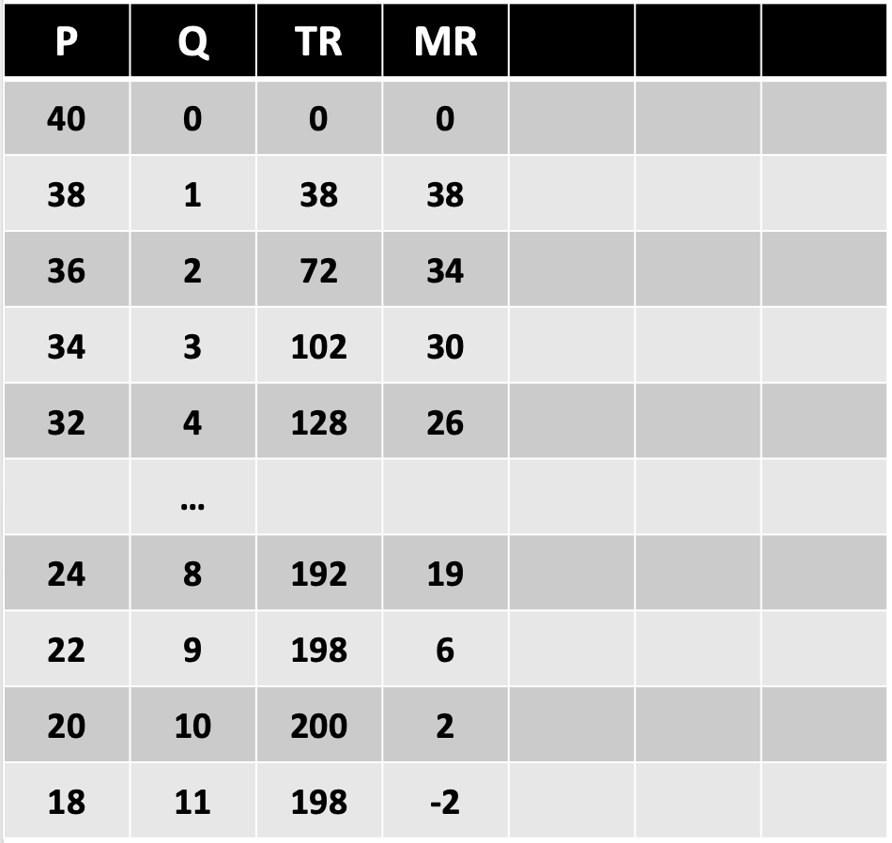
a) What does the Marginal Revenue Curve look like?
P
40
First, the demand curve
20
Q
5
10
EC1101E, NUS, Spring 2020. Week 5. Guillem Riambau

Slide 153
a) What does the Marginal Revenue Curve look like?
P
40
20
Q
5
10
EC1101E, NUS, Spring 2020. Week 5. Guillem Riambau

Slide 154
a) What does the Marginal Revenue Curve look like?
P
40
20
Q
5
10
EC1101E, NUS, Spring 2020. Week 5. Guillem Riambau

Slide 155
a) What does the Marginal Revenue Curve look like?
P
40
20
Q
5
10
EC1101E, NUS, Spring 2020. Week 5. Guillem Riambau

Slide 156
a) What does the Marginal Revenue Curve look like?
P
40
20
Q
5
10
EC1101E, NUS, Spring 2020. Week 5. Guillem Riambau

Slide 157
a) What does the Marginal Revenue Curve look like?
P
40
20
This is the demand curve
Q
5
10
EC1101E, NUS, Spring 2020. Week 5. Guillem Riambau

Slide 158
a) What does the Marginal Revenue Curve look like?
P
40
Now what does marginal revenue look like?
20
Q
5
10
EC1101E, NUS, Spring 2020. Week 5. Guillem Riambau

Slide 159
a) What does the Marginal Revenue Curve look like?
P
40
20
Q
5
10
EC1101E, NUS, Spring 2020. Week 5. Guillem Riambau

Slide 160
a) What does the Marginal Revenue Curve look like?
P
40
20
Q
5
10
EC1101E, NUS, Spring 2020. Week 5. Guillem Riambau

Slide 161
a) What does the Marginal Revenue Curve look like?
P
40
38
36
34
32
30
20
Q
5
10
EC1101E, NUS, Spring 2020. Week 5. Guillem Riambau

Slide 162
a) What does the Marginal Revenue Curve look like?
P
40
38
36
34
32
30
20
Q
5
10
EC1101E, NUS, Spring 2020. Week 5. Guillem Riambau

Slide 163
a) What does the Marginal Revenue Curve look like?
P
40
38
36
34
32
30
20
Q
5
10
EC1101E, NUS, Spring 2020. Week 5. Guillem Riambau

Slide 164
a) What does the Marginal Revenue Curve look like?
P
40
38
36
34
32
30
20
Q
5
10
EC1101E, NUS, Spring 2020. Week 5. Guillem Riambau

Slide 165
a) What does the Marginal Revenue Curve look like?
P
40
38
36
34
32
30
20
Demand Curve
Marginal Revenue
Q
5
10
EC1101E, NUS, Spring 2020. Week 5. Guillem Riambau

Slide 166
Externalities
Marginal Revenue
The decision of the firm: Marginal Cost
Graphical analysis
EC1101E, NUS, Spring 2020. Week 5.

Slide 167
b) What is the optimal quantity for the firm?
P
40
38
36
34
32
30
Note: it is tempting to say that the firm should produce until MR = 0
20
Demand Curve
Marginal Revenue
Q
5
10
EC1101E, NUS, Spring 2020. Week 5. Guillem Riambau

Slide 168
b) What is the optimal quantity for the firm?
P
40
38
36
34
32
30
Why is this not the correct decision for the firm?
20
Demand Curve
Marginal Revenue
Q
5
10
EC1101E, NUS, Spring 2020. Week 5. Guillem Riambau

Slide 169
b) What is the optimal quantity for the firm?
P
40
38
36
34
32
30
.
20
Demand Curve
Marginal Revenue
Q
5
10
EC1101E, NUS, Spring 2020. Week 5. Guillem Riambau

Slide 170
b) What is the optimal quantity for the firm?
P
40
38
36
34
32
30
..
20
Demand Curve
Marginal Revenue
Q
5
10
EC1101E, NUS, Spring 2020. Week 5. Guillem Riambau

Slide 171
b) What is the optimal quantity for the firm?
P
40
38
36
34
32
30
…
20
Demand Curve
Marginal Revenue
Q
5
10
EC1101E, NUS, Spring 2020. Week 5. Guillem Riambau

Slide 172
b) What is the optimal quantity for the firm?
P
40
38
36
34
32
30
We need to know the costs!
20
Demand Curve
Marginal Revenue
Q
5
10
EC1101E, NUS, Spring 2020. Week 5. Guillem Riambau

Slide 173
Maximizing profits
P | Q | TR | MR
40 | 0 | 0 | 0
38 | 1 | 38 | 38
36 | 2 | 72 | 34
34 | 3 | 102 | 30
32 | 4 | 128 | 26
 | …
24 | 8 | 192 | 19
22 | 9 | 198 | 6
20 | 10 | 200 | 2
18 | 11 | 198 | -2
Costs for the firm of producing x
C_{x} = 20 +3Q_{x}
In video lecture
EC1101E, NUS, Spring 2020. Week 5. Guillem Riambau

Slide 174
a) What does the Marginal Revenue Curve look like?
P
Costs for the firm of producing x
C_{x} = 20 +3Q_{x}
Marginal Cost in video lecture
Not very realistic
Q
EC1101E, NUS, Spring 2020. Week 5. Guillem Riambau

Slide 175
Maximizing profits
P | Q | TR | MR
40 | 0 | 0 | 0
38 | 1 | 38 | 38
36 | 2 | 72 | 34
34 | 3 | 102 | 30
32 | 4 | 128 | 26
 | …
24 | 8 | 192 | 19
22 | 9 | 198 | 6
20 | 10 | 200 | 2
18 | 11 | 198 | -2
Costs for the firm of producing x
C_{x} = 20 + Q_{x} - Q_{x}
2
In Zoom class (now)
EC1101E, NUS, Spring 2020. Week 5. Guillem Riambau

Slide 176
a) What does the Marginal Revenue Curve look like?
P
Costs for the firm of producing x
C_{x} = 20 + Q_{x} - Q_{x}
Marginal Cost in this example
Much more realistic
Q
EC1101E, NUS, Spring 2020. Week 5. Guillem Riambau

Slide 177
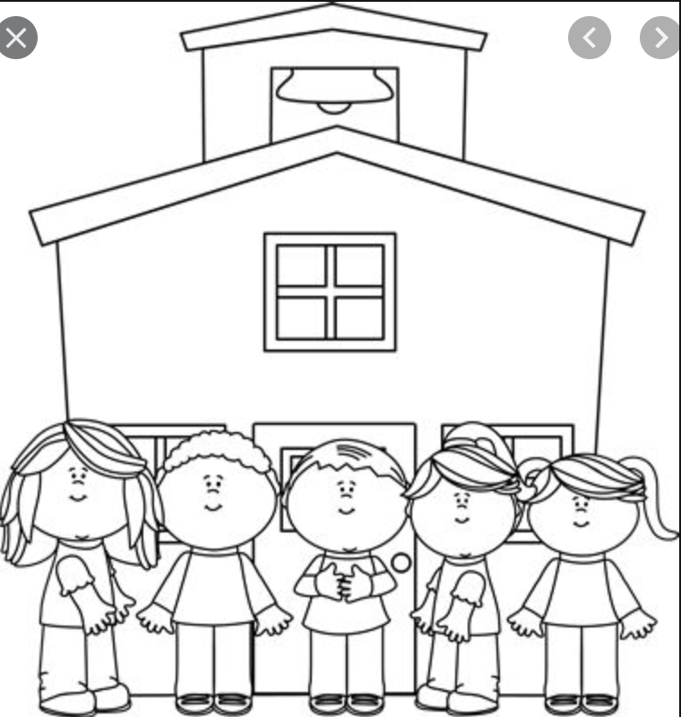
a) What does the Marginal Revenue Curve look like?
P
Costs for the firm of producing x
C_{x} = 20 + Q_{x} - Q_{x}
Marginal Cost in this example
Much more realistic
$
Q
EC1101E, NUS, Spring 2020. Week 5. Guillem Riambau

Slide 178
a) What does the Marginal Revenue Curve look like?
P
Costs for the firm of producing x
C_{x} = 20 + Q_{x} - Q_{x}
Marginal Cost in this example
Much more realistic
$
$$
Q
EC1101E, NUS, Spring 2020. Week 5. Guillem Riambau

Slide 179
a) What does the Marginal Revenue Curve look like?
P
Costs for the firm of producing x
C_{x} = 20 + Q_{x} - Q_{x}
Marginal Cost in this example
Much more realistic
$
$$
$$$
Q
EC1101E, NUS, Spring 2020. Week 5. Guillem Riambau

Slide 180
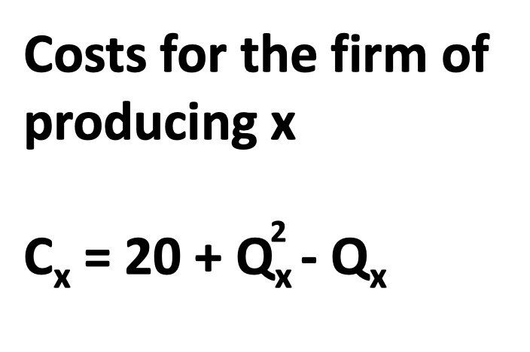
Maximizing profits
P | Q | TR | MR | TC | MC | Profit
40 | 0 | 0 | 0
38 | 1 | 38 | 38
36 | 2 | 72 | 34
34 | 3 | 102 | 30
32 | 4 | 128 | 26
30 | 5 | 150 | 22
28 | 6 | 168 | 18
26 | 7 | 182 | 14
24 | 8 | 192 | 10
EC1101E, NUS, Spring 2020. Week 5. Guillem Riambau

Slide 181
Maximizing profits
P | Q | TR | MR | TC | MC | Profit
40 | 0 | 0 | 0
38 | 1 | 38 | 38
36 | 2 | 72 | 34
34 | 3 | 102 | 30
32 | 4 | 128 | 26
30 | 5 | 150 | 22
28 | 6 | 168 | 18
26 | 7 | 182 | 14
24 | 8 | 192 | 10
Total Costs
EC1101E, NUS, Spring 2020. Week 5. Guillem Riambau

Slide 182
Maximizing profits
P | Q | TR | MR | TC | MC | Profit
40 | 0 | 0 | 0
38 | 1 | 38 | 38
36 | 2 | 72 | 34
34 | 3 | 102 | 30
32 | 4 | 128 | 26
30 | 5 | 150 | 22
28 | 6 | 168 | 18
26 | 7 | 182 | 14
24 | 8 | 192 | 10
Marginal Costs
EC1101E, NUS, Spring 2020. Week 5. Guillem Riambau

Slide 183
Maximizing profits
P | Q | TR | MR | TC | MC | Profit
40 | 0 | 0 | 0
38 | 1 | 38 | 38
36 | 2 | 72 | 34
34 | 3 | 102 | 30
32 | 4 | 128 | 26
30 | 5 | 150 | 22
28 | 6 | 168 | 18
26 | 7 | 182 | 14
24 | 8 | 192 | 10
Marginal Costs: cost of every additional unit
EC1101E, NUS, Spring 2020. Week 5. Guillem Riambau

Slide 184
Maximizing profits
P | Q | TR | MR | TC | MC | Profit
40 | 0 | 0 | 0
38 | 1 | 38 | 38
36 | 2 | 72 | 34
34 | 3 | 102 | 30
32 | 4 | 128 | 26
30 | 5 | 150 | 22
28 | 6 | 168 | 18
26 | 7 | 182 | 14
24 | 8 | 192 | 10
Profit =
Total Revenue – Total Cost
EC1101E, NUS, Spring 2020. Week 5. Guillem Riambau

Slide 185
Maximizing profits
P | Q | TR | MR | TC | MC | Profit
40 | 0 | 0 | 0 | 20 | 0
38 | 1 | 38 | 38 | 20
36 | 2 | 72 | 34
34 | 3 | 102 | 30
32 | 4 | 128 | 26
30 | 5 | 150 | 22
28 | 6 | 168 | 18
26 | 7 | 182 | 14
24 | 8 | 192 | 10
EC1101E, NUS, Spring 2020. Week 5. Guillem Riambau

Slide 186
Maximizing profits
P | Q | TR | MR | TC | MC | Profit
40 | 0 | 0 | 0 | 20 | 0
38 | 1 | 38 | 38 | 20
36 | 2 | 72 | 34
34 | 3 | 102 | 30
32 | 4 | 128 | 26
30 | 5 | 150 | 22
28 | 6 | 168 | 18
26 | 7 | 182 | 14
24 | 8 | 192 | 10
EC1101E, NUS, Spring 2020. Week 5. Guillem Riambau

Slide 187
Maximizing profits
P | Q | TR | MR | TC | MC | Profit
40 | 0 | 0 | 0 | 20 | 0
38 | 1 | 38 | 38 | 20
36 | 2 | 72 | 34 | 22
34 | 3 | 102 | 30
32 | 4 | 128 | 26
30 | 5 | 150 | 22
28 | 6 | 168 | 18
26 | 7 | 182 | 14
24 | 8 | 192 | 10
EC1101E, NUS, Spring 2020. Week 5. Guillem Riambau

Slide 188
Maximizing profits
P | Q | TR | MR | TC | MC | Profit
40 | 0 | 0 | 0 | 20 | 0
38 | 1 | 38 | 38 | 20
36 | 2 | 72 | 34 | 22
34 | 3 | 102 | 30 | 26
32 | 4 | 128 | 26
30 | 5 | 150 | 22
28 | 6 | 168 | 18
26 | 7 | 182 | 14
24 | 8 | 192 | 10
EC1101E, NUS, Spring 2020. Week 5. Guillem Riambau

Slide 189
Maximizing profits
P | Q | TR | MR | TC | MC | Profit
40 | 0 | 0 | 0 | 20 | 0
38 | 1 | 38 | 38 | 20
36 | 2 | 72 | 34 | 22
34 | 3 | 102 | 30 | 26
32 | 4 | 128 | 26 | 32
30 | 5 | 150 | 22 | 40
28 | 6 | 168 | 18 | 50
26 | 7 | 182 | 14 | 62
24 | 8 | 192 | 10 | 76
EC1101E, NUS, Spring 2020. Week 5. Guillem Riambau

Slide 190
Maximizing profits
P | Q | TR | MR | TC | MC | Profit
40 | 0 | 0 | 0 | 20 | 0
38 | 1 | 38 | 38 | 20
36 | 2 | 72 | 34 | 22
34 | 3 | 102 | 30 | 26
32 | 4 | 128 | 26 | 32
30 | 5 | 150 | 22 | 40
28 | 6 | 168 | 18 | 50
26 | 7 | 182 | 14 | 62
24 | 8 | 192 | 10 | 76
EC1101E, NUS, Spring 2020. Week 5. Guillem Riambau

Slide 191
Maximizing profits
P | Q | TR | MR | TC | MC | Profit
40 | 0 | 0 | 0 | 20 | 0
38 | 1 | 38 | 38 | 20 | 0
36 | 2 | 72 | 34 | 22
34 | 3 | 102 | 30 | 26
32 | 4 | 128 | 26 | 32
30 | 5 | 150 | 22 | 40
28 | 6 | 168 | 18 | 50
26 | 7 | 182 | 14 | 62
24 | 8 | 192 | 10 | 76
EC1101E, NUS, Spring 2020. Week 5. Guillem Riambau

Slide 192
Maximizing profits
P | Q | TR | MR | TC | MC | Profit
40 | 0 | 0 | 0 | 20 | 0
38 | 1 | 38 | 38 | 20 | 0
36 | 2 | 72 | 34 | 22 | 2
34 | 3 | 102 | 30 | 26
32 | 4 | 128 | 26 | 32
30 | 5 | 150 | 22 | 40
28 | 6 | 168 | 18 | 50
26 | 7 | 182 | 14 | 62
24 | 8 | 192 | 10 | 76
EC1101E, NUS, Spring 2020. Week 5. Guillem Riambau

Slide 193
Maximizing profits
P | Q | TR | MR | TC | MC | Profit
40 | 0 | 0 | 0 | 20 | 0
38 | 1 | 38 | 38 | 20 | 0
36 | 2 | 72 | 34 | 22 | 2
34 | 3 | 102 | 30 | 26 | 4
32 | 4 | 128 | 26 | 32
30 | 5 | 150 | 22 | 40
28 | 6 | 168 | 18 | 50
26 | 7 | 182 | 14 | 62
24 | 8 | 192 | 10 | 76
EC1101E, NUS, Spring 2020. Week 5. Guillem Riambau

Slide 194
Maximizing profits
P | Q | TR | MR | TC | MC | Profit
40 | 0 | 0 | 0 | 20 | 0
38 | 1 | 38 | 38 | 20 | 0
36 | 2 | 72 | 34 | 22 | 2
34 | 3 | 102 | 30 | 26 | 4
32 | 4 | 128 | 26 | 32 | 6
30 | 5 | 150 | 22 | 40 | 8
28 | 6 | 168 | 18 | 50 | 10
26 | 7 | 182 | 14 | 62 | 12
24 | 8 | 192 | 10 | 76 | 14
EC1101E, NUS, Spring 2020. Week 5. Guillem Riambau

Slide 195
Maximizing profits
P | Q | TR | MR | TC | MC | Profit
40 | 0 | 0 | 0 | 20 | 0
38 | 1 | 38 | 38 | 20 | 0
36 | 2 | 72 | 34 | 22 | 2
34 | 3 | 102 | 30 | 26 | 4
32 | 4 | 128 | 26 | 32 | 6
30 | 5 | 150 | 22 | 40 | 8
28 | 6 | 168 | 18 | 50 | 10
26 | 7 | 182 | 14 | 62 | 12
24 | 8 | 192 | 10 | 76 | 14
Can the firm decide just with this information?
EC1101E, NUS, Spring 2020. Week 5. Guillem Riambau

Slide 196
Maximizing profits
P | Q | TR | MR | TC | MC | Profit
40 | 0 | 0 | 0 | 20 | 0
38 | 1 | 38 | 38 | 20 | 0
36 | 2 | 72 | 34 | 22 | 2
34 | 3 | 102 | 30 | 26 | 4
32 | 4 | 128 | 26 | 32 | 6
30 | 5 | 150 | 22 | 40 | 8
28 | 6 | 168 | 18 | 50 | 10
26 | 7 | 182 | 14 | 62 | 12
24 | 8 | 192 | 10 | 76 | 14
CAN!
EC1101E, NUS, Spring 2020. Week 5. Guillem Riambau

Slide 197
Maximizing profits
P | Q | TR | MR | TC | MC | Profit
40 | 0 | 0 | 0 | 20 | 0
38 | 1 | 38 | 38 | 20 | 0
36 | 2 | 72 | 34 | 22 | 2
34 | 3 | 102 | 30 | 26 | 4
32 | 4 | 128 | 26 | 32 | 6
30 | 5 | 150 | 22 | 40 | 8
28 | 6 | 168 | 18 | 50 | 10
26 | 7 | 182 | 14 | 62 | 12
24 | 8 | 192 | 10 | 76 | 14
EC1101E, NUS, Spring 2020. Week 5. Guillem Riambau

Slide 198
Maximizing profits
P | Q | TR | MR | TC | MC | Profit
40 | 0 | 0 | 0 | 20 | 0
38 | 1 | 38 | 38 | 20 | 0
36 | 2 | 72 | 34 | 22 | 2
34 | 3 | 102 | 30 | 26 | 4
32 | 4 | 128 | 26 | 32 | 6
30 | 5 | 150 | 22 | 40 | 8
28 | 6 | 168 | 18 | 50 | 10
26 | 7 | 182 | 14 | 62 | 12
24 | 8 | 192 | 10 | 76 | 14
EC1101E, NUS, Spring 2020. Week 5. Guillem Riambau

Slide 199
Maximizing profits
P | Q | TR | MR | TC | MC | Profit
40 | 0 | 0 | 0 | 20 | 0
38 | 1 | 38 | 38 | 20 | 0
36 | 2 | 72 | 34 | 22 | 2
34 | 3 | 102 | 30 | 26 | 4
32 | 4 | 128 | 26 | 32 | 6
30 | 5 | 150 | 22 | 40 | 8
28 | 6 | 168 | 18 | 50 | 10
26 | 7 | 182 | 14 | 62 | 12
24 | 8 | 192 | 10 | 76 | 14
EC1101E, NUS, Spring 2020. Week 5. Guillem Riambau

Slide 200
Maximizing profits
P | Q | TR | MR | TC | MC | Profit
40 | 0 | 0 | 0 | 20 | 0
38 | 1 | 38 | 38 | 20 | 0
36 | 2 | 72 | 34 | 22 | 2
34 | 3 | 102 | 30 | 26 | 4
32 | 4 | 128 | 26 | 32 | 6
30 | 5 | 150 | 22 | 40 | 8
28 | 6 | 168 | 18 | 50 | 10
26 | 7 | 182 | 14 | 62 | 12
24 | 8 | 192 | 10 | 76 | 14
Unit 8 is not worth producing
EC1101E, NUS, Spring 2020. Week 5. Guillem Riambau

Slide 201
Maximizing profits
P | Q | TR | MR | TC | MC | Profit
40 | 0 | 0 | 0 | 20 | 0
38 | 1 | 38 | 38 | 20 | 0
36 | 2 | 72 | 34 | 22 | 2
34 | 3 | 102 | 30 | 26 | 4
32 | 4 | 128 | 26 | 32 | 6
30 | 5 | 150 | 22 | 40 | 8
28 | 6 | 168 | 18 | 50 | 10
26 | 7 | 182 | 14 | 62 | 12
24 | 8 | 192 | 10 | 76 | 14
Unit 8 is not worth producing. Let’s check!
EC1101E, NUS, Spring 2020. Week 5. Guillem Riambau

Slide 202
Maximizing profits
P | Q | TR | MR | TC | MC | Profit
40 | 0 | 0 | 0 | 20 | 0 | -20
38 | 1 | 38 | 38 | 20 | 0
36 | 2 | 72 | 34 | 22 | 2
34 | 3 | 102 | 30 | 26 | 4
32 | 4 | 128 | 26 | 32 | 6
30 | 5 | 150 | 22 | 40 | 8
28 | 6 | 168 | 18 | 50 | 10
26 | 7 | 182 | 14 | 62 | 12
24 | 8 | 192 | 10 | 76 | 14
Unit 8 is not worth producing. Let’s check!
EC1101E, NUS, Spring 2020. Week 5. Guillem Riambau

Slide 203
Maximizing profits
P | Q | TR | MR | TC | MC | Profit
40 | 0 | 0 | 0 | 20 | 0 | -20
38 | 1 | 38 | 38 | 20 | 0 | 18
36 | 2 | 72 | 34 | 22 | 2
34 | 3 | 102 | 30 | 26 | 4
32 | 4 | 128 | 26 | 32 | 6
30 | 5 | 150 | 22 | 40 | 8
28 | 6 | 168 | 18 | 50 | 10
26 | 7 | 182 | 14 | 62 | 12
24 | 8 | 192 | 10 | 76 | 14
Unit 8 is not worth producing. Let’s check!
EC1101E, NUS, Spring 2020. Week 5. Guillem Riambau

Slide 204
Maximizing profits
P | Q | TR | MR | TC | MC | Profit
40 | 0 | 0 | 0 | 20 | 0 | -20
38 | 1 | 38 | 38 | 20 | 0 | 18
36 | 2 | 72 | 34 | 22 | 2 | 50
34 | 3 | 102 | 30 | 26 | 4
32 | 4 | 128 | 26 | 32 | 6
30 | 5 | 150 | 22 | 40 | 8
28 | 6 | 168 | 18 | 50 | 10
26 | 7 | 182 | 14 | 62 | 12
24 | 8 | 192 | 10 | 76 | 14
Unit 8 is not worth producing. Let’s check!
EC1101E, NUS, Spring 2020. Week 5. Guillem Riambau

Slide 205
Maximizing profits
P | Q | TR | MR | TC | MC | Profit
40 | 0 | 0 | 0 | 20 | 0 | -20
38 | 1 | 38 | 38 | 20 | 0 | 18
36 | 2 | 72 | 34 | 22 | 2 | 50
34 | 3 | 102 | 30 | 26 | 4 | 76
32 | 4 | 128 | 26 | 32 | 6 | 96
30 | 5 | 150 | 22 | 40 | 8 | 110
28 | 6 | 168 | 18 | 50 | 10 | 118
26 | 7 | 182 | 14 | 62 | 12 | 120
24 | 8 | 192 | 10 | 76 | 14 | 116
Unit 8 is not worth producing. Let’s check!
EC1101E, NUS, Spring 2020. Week 5. Guillem Riambau

Slide 206
Maximizing profits
P | Q | TR | MR | TC | MC | Profit
40 | 0 | 0 | 0 | 20 | 0 | -20
38 | 1 | 38 | 38 | 20 | 0 | 18
36 | 2 | 72 | 34 | 22 | 2 | 50
34 | 3 | 102 | 30 | 26 | 4 | 76
32 | 4 | 128 | 26 | 32 | 6 | 96
30 | 5 | 150 | 22 | 40 | 8 | 110
28 | 6 | 168 | 18 | 50 | 10 | 118
26 | 7 | 182 | 14 | 62 | 12 | 120
24 | 8 | 192 | 10 | 76 | 14 | 116
Profit maximized at 7 units
Unit 8 is not worth producing. Let’s check!
EC1101E, NUS, Spring 2020. Week 5. Guillem Riambau

Slide 207
Maximizing profits
P | Q | TR | MR | TC | MC | Profit
40 | 0 | 0 | 0 | 20 | 0 | -20
38 | 1 | 38 | 38 | 20 | 0 | 18
36 | 2 | 72 | 34 | 22 | 2 | 50
34 | 3 | 102 | 30 | 26 | 4 | 76
32 | 4 | 128 | 26 | 32 | 6 | 96
30 | 5 | 150 | 22 | 40 | 8 | 110
28 | 6 | 168 | 18 | 50 | 10 | 118
26 | 7 | 182 | 14 | 62 | 12 | 120
24 | 8 | 192 | 10 | 76 | 14 | 116
Profit maximized at 7 units
Exactly as marginal analysis has predicted
Unit 8 is not worth producing. Let’s check!
EC1101E, NUS, Spring 2020. Week 5. Guillem Riambau

Slide 208
Externalities
Marginal Revenue
The decision of the firm: Marginal Cost
Graphical analysis
EC1101E, NUS, Spring 2020. Week 5.

Slide 209
Maximizing profits
P
40
38
36
34
32
How does this look graphically?
30
20
Demand Curve
Marginal Revenue
Q
7
5
8
10
EC1101E, NUS, Spring 2020. Week 5. Guillem Riambau

Slide 210
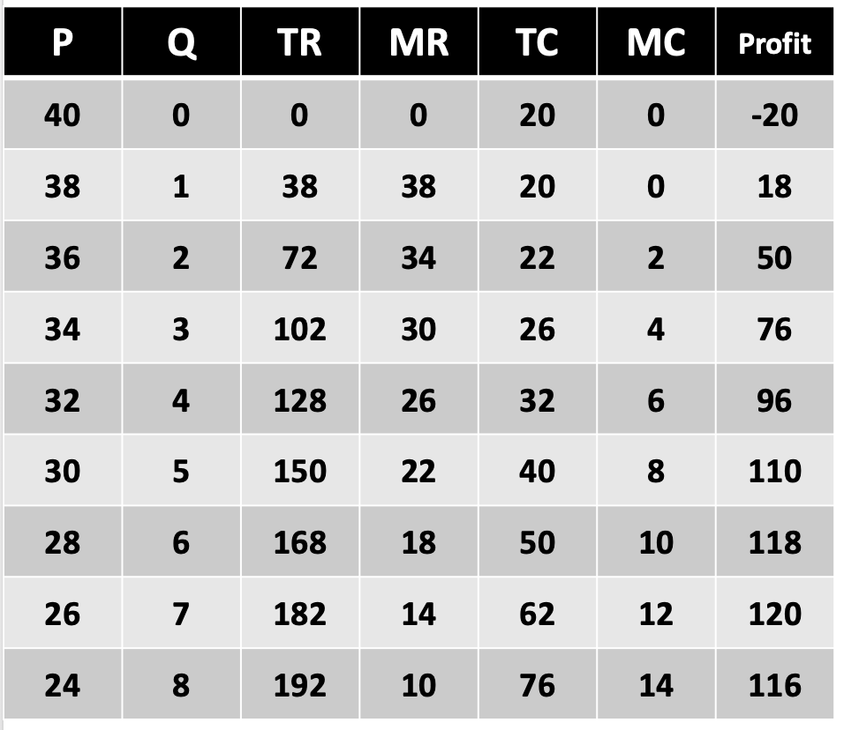
Maximizing profits
P
40
38
36
34
32
30
20
Demand Curve
Marginal Revenue
Q
7
5
8
10
EC1101E, NUS, Spring 2020. Week 5. Guillem Riambau

Slide 211
Maximizing profits
P
40
38
36
34
32
30
20
Demand Curve
Marginal Revenue
Q
7
5
8
10
EC1101E, NUS, Spring 2020. Week 5. Guillem Riambau

Slide 212
Maximizing profits
P
40
38
36
34
32
30
20
Demand Curve
Marginal Revenue
Q
7
5
8
10
EC1101E, NUS, Spring 2020. Week 5. Guillem Riambau

Slide 213
Maximizing profits
P
40
38
36
34
32
30
20
Demand Curve
Marginal Revenue
Q
7
5
8
10
EC1101E, NUS, Spring 2020. Week 5. Guillem Riambau

Slide 214
Maximizing profits
P
40
38
36
34
32
30
20
Demand Curve
Marginal Revenue
Q
7
5
8
10
EC1101E, NUS, Spring 2020. Week 5. Guillem Riambau

Slide 215
Maximizing profits
P
40
38
36
→ This firm should produce 7 units
34
32
30
20
Demand Curve
Marginal Revenue
Q
7
5
8
10
EC1101E, NUS, Spring 2020. Week 5. Guillem Riambau

Slide 216
Takeaways
EC1101E, NUS, Spring 2020. Week 5. Guillem Riambau

Slide 217
Takeaways
Negative externalities: too much consumption/production
Positive externalities: not enough consumption/production
In both cases, need government intervention to prevent Deadweight Loss
How do firms decide exactly how much to produce? Marginal analysis: MC vs MR
EC1101E, NUS, Spring 2020. Week 5. Guillem Riambau

Slide 218
Takeaways
Negative externalities: too much consumption/production
Positive externalities: not enough consumption/production
In both cases, need government intervention to prevent Deadweight Loss
How do firms decide exactly how much to produce? Marginal analysis: MC vs MR
EC1101E, NUS, Spring 2020. Week 5. Guillem Riambau

Slide 219
Takeaways
Negative externalities: too much consumption/production
Positive externalities: not enough consumption/production
In both cases, need government intervention to prevent Deadweight Loss
How do firms decide exactly how much to produce? Marginal analysis: MC vs MR
EC1101E, NUS, Spring 2020. Week 5. Guillem Riambau

Slide 220
Next
E-Exam Demo! Stay online please!
EC1101E, NUS, Spring 2020. Week 5. Guillem Riambau

Slide 221
Next week
Monopolies
Intro to game theory
EC1101E, NUS, Spring 2020. Week 5. Guillem Riambau

